Slide 1

PROJECT 1

Slide 2
Project 1 Team
Irene Zou
Jeff Lyng
David Stagner

Slide 3
HYPOTHESIS
Olympic athletes have improved performance significantly over time.

Slide 4
Project Overview
We will analyze summer Olympic games gold medalist data from 1896 to 2016 for 5 specific track & field events for both male and female.
100 meter
800 meter
10,000 meter
High Jump
Discus
We will also analyze height and weight data for the athletes that competed in these events.
Data Source
Kaggle
Olympic Track & Field Results csv
120 Years of Olympic History: Athletes and Results csv

Slide 5
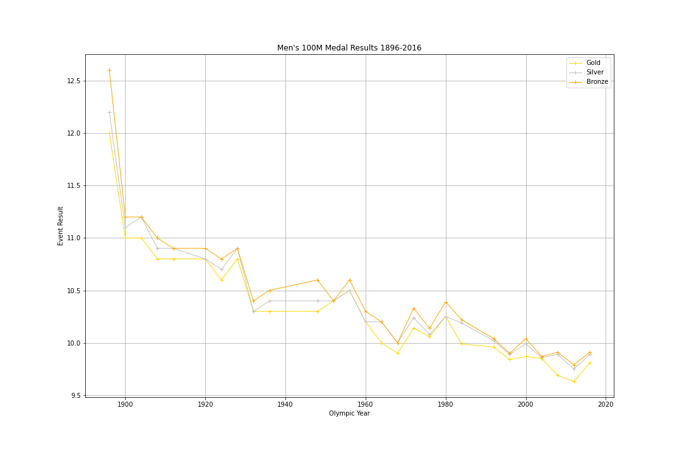
100 Meter Results

Slide 6
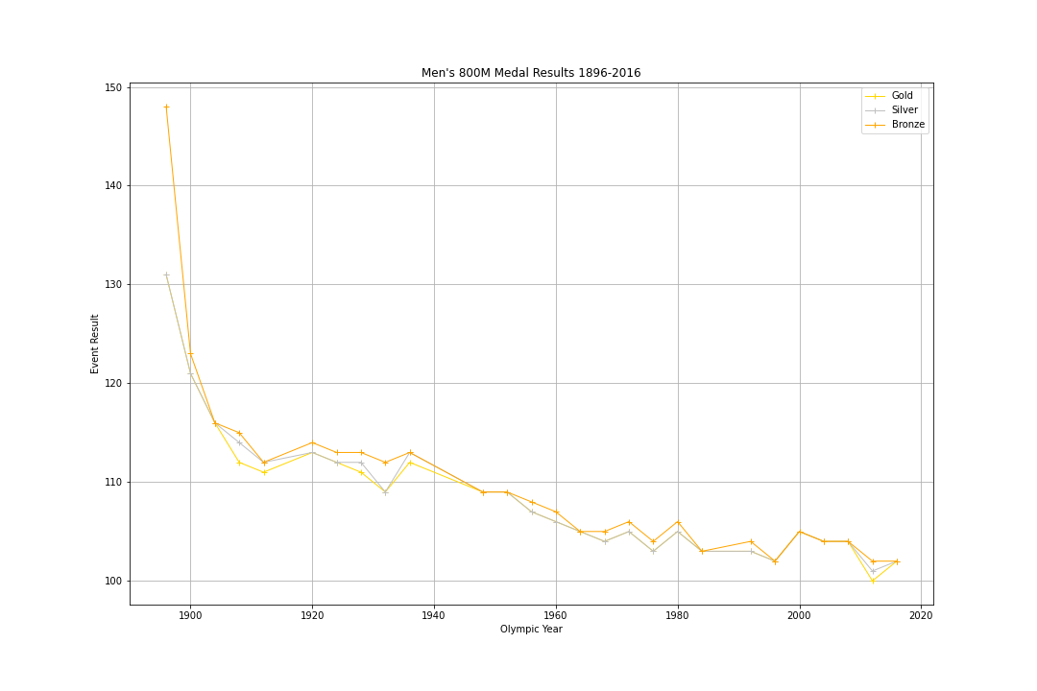
800 Meter Results

Slide 7
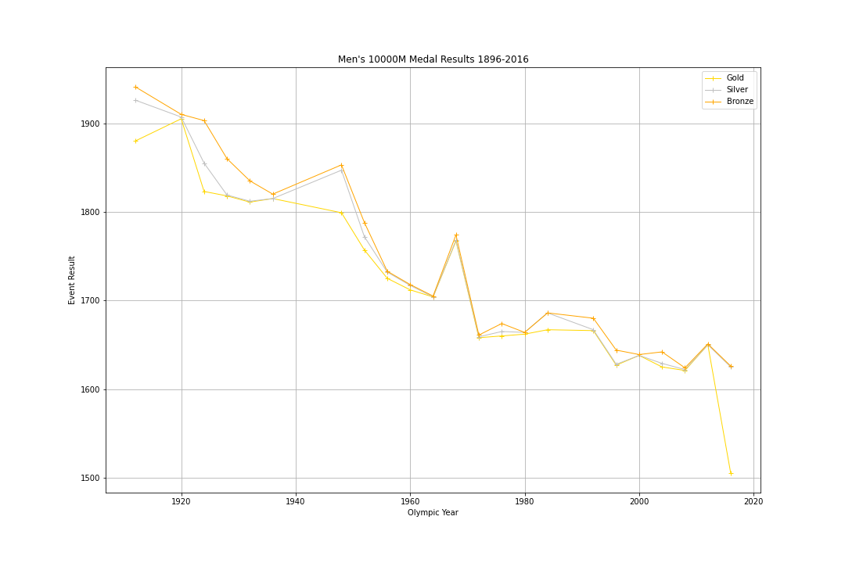
10,000 Meter Results

Slide 8
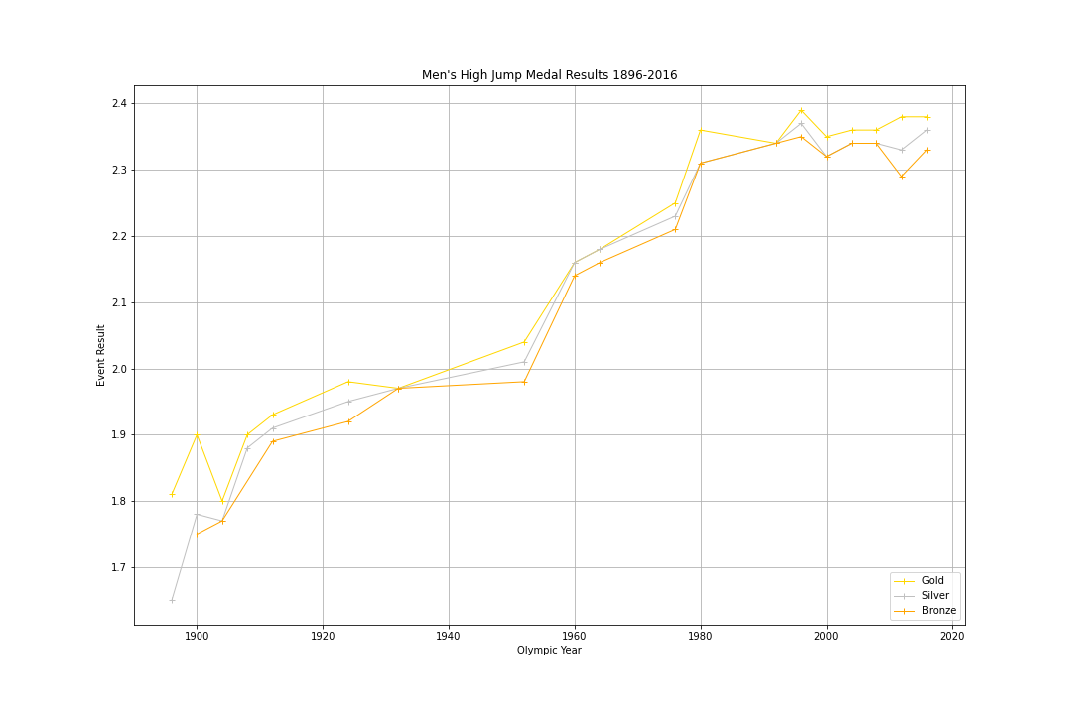
High Jump Results

Slide 9
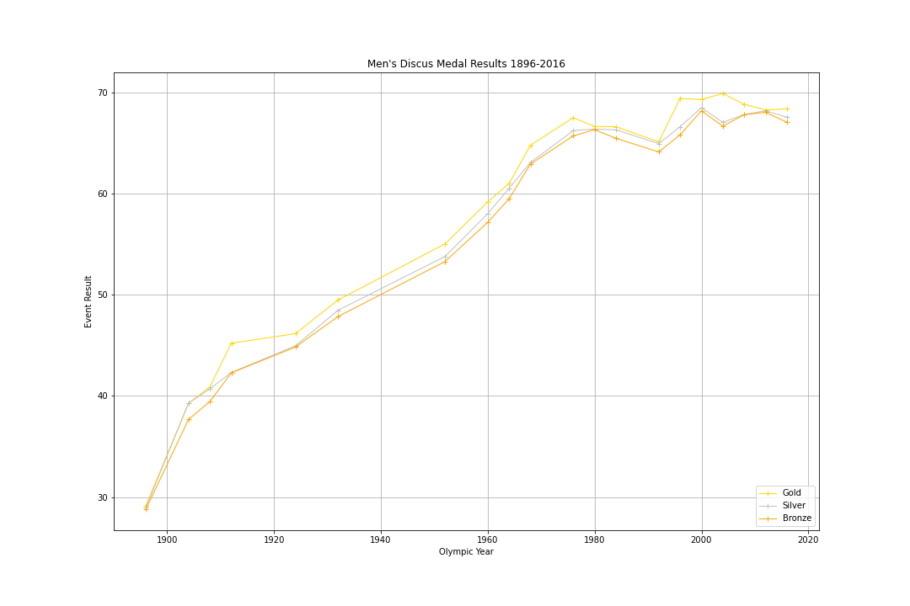
Discus Results

